Slide 1

Historic Nashville City Cemetery 1846-1979
The Journey of Preservation: Evolving Efforts and Growing Awareness.
By: Renuka Deshmukh

Slide 2
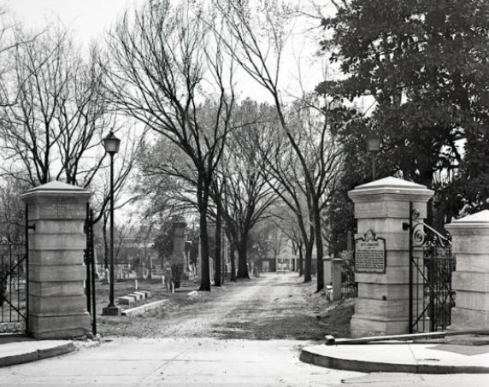
Preserving the History
The Nashville City Cemetery was listed on the National Register of Historic Places in 1972.
When | Listed in 1972
Why | For its historical and architectural significance
Benefits | The cemetery is protected, preserved, and restored. The Nashville City Cemetery Association works with the Historical Commission to raise awareness and care for the cemetery.

Slide 3

Early practices of Preservation
Maintenance: The sale of lots and by other fees, such as for digging graves by appointed Sexton.
Manual recording: In 1822 Captain Alpha Kingsley was hired to be the first sexton of the new city cemetery. He was also responsible for Interment books.
Vandalization and Loss of records: Loss of burial records along with vandalism happened between 1822 and 1846 during Civil War.

Slide 4
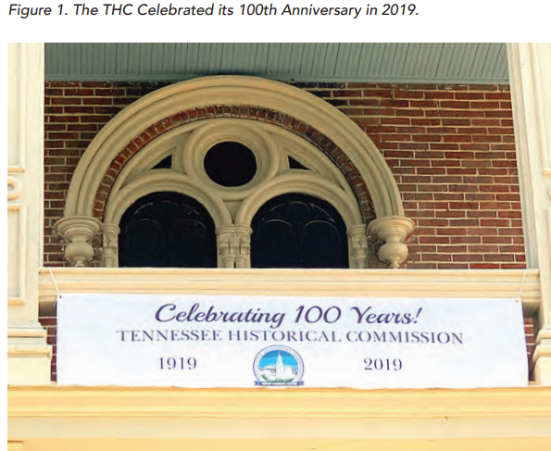
Awareness Programs:
Nashville city cemetery association NCCA formed in 1998 by a group of citizens interested in restoring the Nashville City Cemetery.
Tours
Scavenger hunts
Website
Membership
Partnerships

Slide 5

Questions:
How can I contribute?
What can be done along with existing awareness programs and events?
How to balance new surge of growth of a Nashville city area and a preservation efforts of city history?

Slide 6

Possible Solution:
Social Studies
Making future generation part of the city history
Introducing City based curriculum in existing Social Study subject in early childhood years.
Adding historic places of city, it’s significance and program to build respect about it.

Slide 7

Thank You!
Resources:
https://thenashvillecitycemetery.org/restoration-history
https://library.nashville.org/blog/2022/02/tales-crypt-nashville-city-cemetery-edition
Generic Google search for images and information.
Dataset provided by Historic Nashville city cemetery association.

